Slide 1
Reclaiming Technology
UTOPIA(S) RELOADED
26-28 October 2023
Vienna - Austria
Yagmur Denizhan
Electrical and Electronics Engg. Dept.
Bogazici University, Istanbul - Turkey

Slide 2
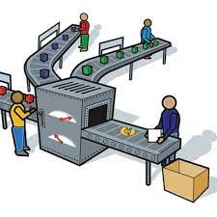
Reclaiming technological decision making
From whom?
***crats and their “rationality”
Prerogative of devising a narrative with an internal “logic”
Organised ignorance
Reductionist economic rationality
=> Rules of conduct:
isolation
loss of trust
loss of respect
loss of autonomy
loss of sense of responsibility
loss of motivation
loss of hope
submission
learnt helplessness
compartmentalisation
maximisation
standardisation
algorithmisation
automation
digitisation
…

Slide 3
Reclaiming technological decision making
In whose name?
in the name of all who are going to be affected…
in the name of all knowledge and all disciplines
ignored and excluded from the process of decision making…
too utopian?

Slide 4
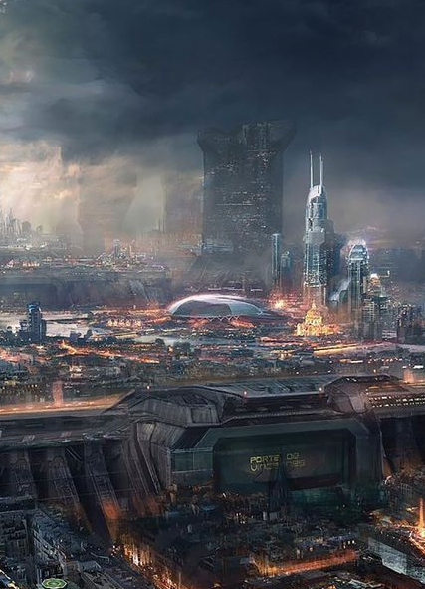
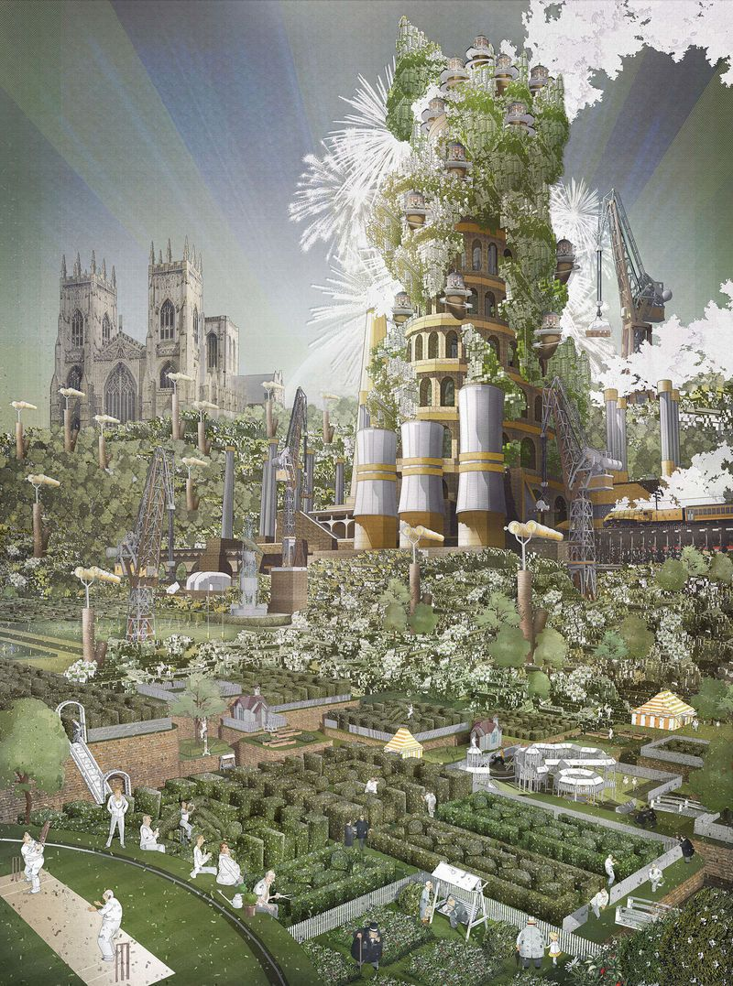
Utopias, dystopias and technology
Reclaiming technological decision making
,
ου + τóπος
= no + place
,
˜
= good + place
ευ + τóπος
unrealistic
non-implementable
irrational (!)
common-sensical
viable
sustainable
in its essence, but
non-existing
(sarcastically)
not accessible
from the present state
stance of the status quo
stance of the change seekers
Utopia: (re)establishment of resonance
dissonance in the present “order”

Slide 5
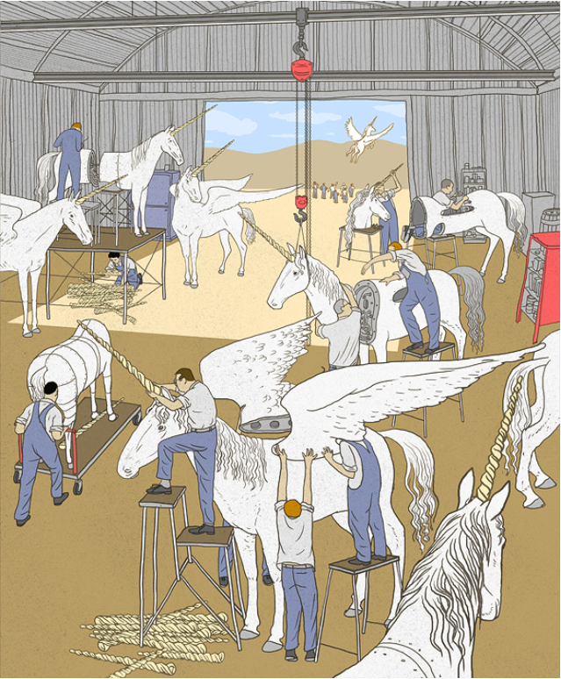
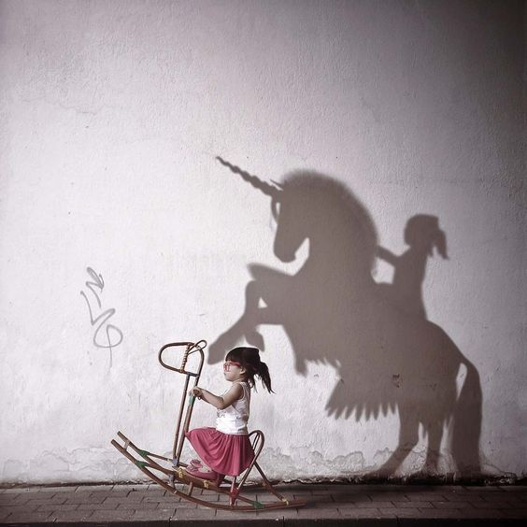
Utopias, dystopias and technology
Unicorn assembly line, Yizhar Cohen
I Have a Dream, Kate Wesson

Slide 6
Reclaiming technology
Reclaiming technological decision making
compartmentalisation
maximisation
standardisation
algorithmisation
automation
digitisation
…
In whose name?
in the name of all who are going to be affected…
in the name of all knowledge and all disciplines
ignored and excluded from the process of decision making…
isolation
loss of trust
loss of respect
loss of autonomy
loss of sense of responsibility
loss of motivation
loss of hope
submission
learnt helplessness
?
Technology is too important to be left to the disposal of those who create the dissonance!
abandon

Slide 7
Reclaiming technology
Transformation?
compartmentalisation
maximisation
standardisation
algorithmisation
automation
digitisation
…
offer opportunities to convert awareness into action
“un-teach” helplessness:
Exceptions break the rules!
create small niches where
inter- and transdisciplinary collaboration
different rules of conduct
trust & respect
motivation
hope
can emerge spontaneously
as a solution to real problems
while safeguarding the essence of the Utopia
isolation
loss of trust
loss of respect
loss of autonomy
loss of sense of responsibility
loss of motivation
loss of hope
submission
learnt helplessness
?

Slide 8
Transformation
https://gsis.at/
The vision
By doing use-inspired basic research the Institute shall provide civil society, governments and businesses with a better understanding of social transformation processes.
Moreover, it shall facilitate the design of the transformation of social systems into building blocks of a Global Sustainable Information Society. A Global Sustainable Information Society would allow for another step in the evolution of humanity. It would cope with the global challenges that are caused by social dysfunctions and require a re-organisation of the current state of world order.
Based upon that vision, the mission can identify enablers and constraints on the way to a better future.

Slide 9
Transformation

