Slide 1
Overcoming the Current Violent Capitalist Accumulation Favored by the “New Enclosures” Degradation of Women, Lockdowns, Looting Finance, War, Plunder Now Lorenzo Magnani
UTOPIA(S) RELOADED:
Science, Activism and the Techno-Eco-Social Transformation
26-28 October 2023
4lthangrund, Augasse 2-6, 1090 Wien
Notes:
First slide

Slide 3
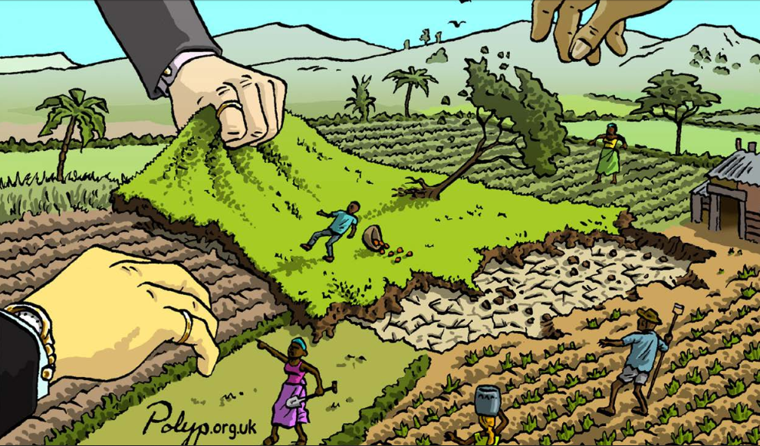
THE ROLE OF THE ENCLOSURES IN CAPITALISTIC PRIMITIVE ACCUMULATION
The so-called “enclosures” starting on XII century – masterfully analyzed by Marx - were fundamental procedures that favored the “primitive accumulation”, that is, the first social and economical step that led to capitalism. The “enclosures” that characterized the primitive accumulation process, aggressively expropriating peasants, razing their cottages and dwellings, were characterized by variegated violent processes.

Slide 4
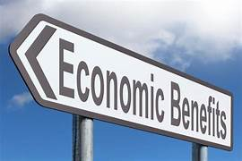
It can be said that the enclosures were rendered necessary because of the augmented demand for agricultural goods and sheep’s wool related to textile manufacture: the peasants were not in a condition to improve the efficiency of their work on the land. It is important to note that this explanation always worked as economical justifications capable to conceal the violent acts perpetrated against the peasants during those processes, as was testified by some protests against the extirpation of rights from common people. We are in presence of what I called “moral bubble”, in this case based on edifying economic narratives, which are characterized by the rational force of the “objectivity”.

Slide 5
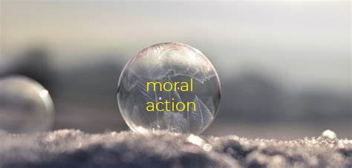
MORAL BUBBLES JUSTIFY ENCLOSURES
Thanks to the moral bubble, humans consciously choose a moral attitude (in the case of the enclosures substantiated by the expected economical benefits) – to perform moral actions on its behalf – and at the same time feel correct and good concealing the possible violent consequences. Paradoxically, we keep and trust a moral belief – based on an axiological conviction – even if, contradictorily, we have fresh knowledge which shows it leads to potential – sometimes atrocious – dangerous and violent outcomes..
The moral bubble grants that enclosures are just peaceful and fruitful and the possible violent acts perpetrable are concealed.

Slide 6
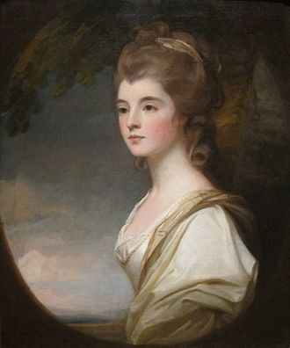
Marx in the chapter 26 of the first volume of Capital enumerated and richly described at least 20 horrible violent aspects of the so-called “enclosures”: The following is a clear case: “As an example of the method used in the nineteenth century, the ‘clearings’ made by the Duchess of Sutherland, well instructed in economics, resolved, when she succeeded to the headship of the clan, to undertake a radical economic cure, and to turn the whole county of Sutherland into a sheep-walk. Between 1814 and 1820 these 15000 inhabitants, about 3000 families, were systematically hunted and rooted out. All their villages were destroyed and burnt, all their fields turned into pasturage. Between 1811 and 1821, around 15000 people were removed from land owned by the Duchess of Sutherland and her husband the Marquis of Stafford to make room for 200000 sheep. British soldiers enforced this mass of evictions, and came to blows with the inhabitants. One old woman was burnt to death in the flames of the hut when she refused to leave. It was in this manner that this fine lady appropriated 794000 acres of land which had belonged to the clan from time immemorial”.

Slide 7
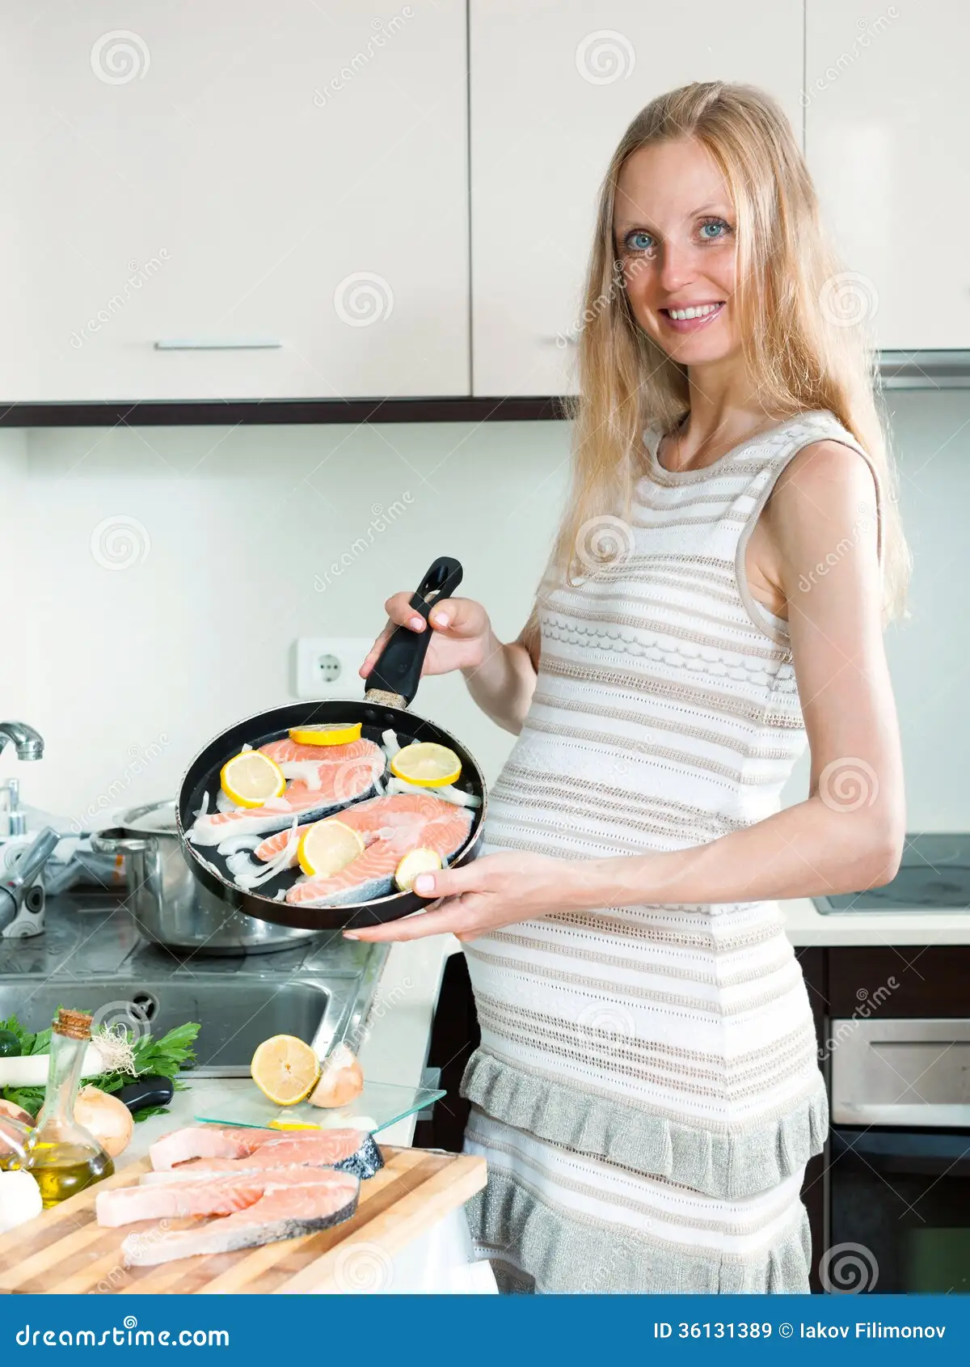
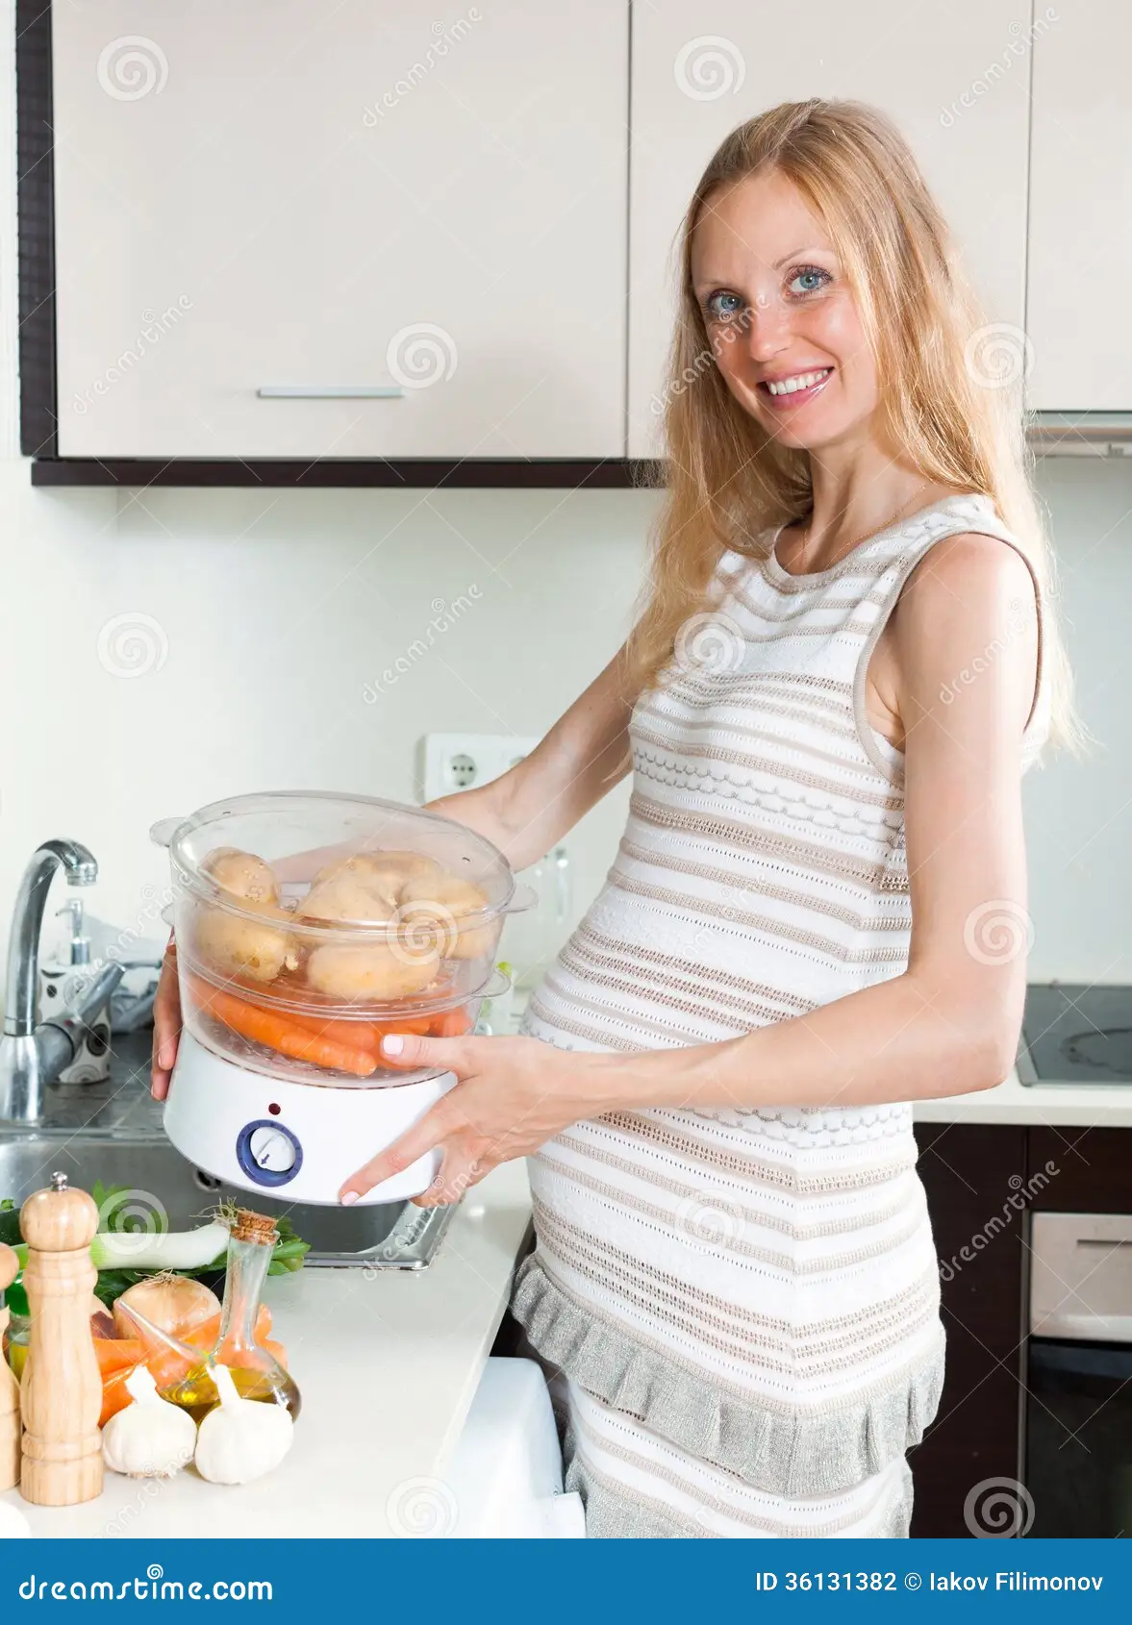
First of all women were exploited at the time of capitalistic primitive accumulation becoming machines for the production of new workers: when common lands were destroyed by the enclosures women became the new communal good, husbands received women’s "wage", because they collaborate and work but women are not paid, so creating the so-called new “patriarchy of the wage”. It is in this sense that women/housewives constituted and now still constitute the optimal labor force for the capitalist, in so far as they are not considered workers: the so-called “housewifization”, a kind of enclosure of women, worsened by the recent neoliberal economy – related to the universalization of the model of the nuclear family - is indeed a kind of externalization of costs that consequently do not have to be paid by the capitalists.
Furthermore, the increasing privatization of social services, previously furnished by the welfare state, has ended up determining a further increase of work for housewives: the ideological command regarding the famous “flexibilization of labor” has managed to promote further unpaid female work.

Slide 8
Lockdowns
The struggle against deaths due to COVID concealed the violent effects of lockdowns and their consequences in terms of expropriation and impoverishment of large categories of people; the victims, terrified because of the imminent possibility of dying, and overwhelmed by a distant scientific/technical knowledge endowed with an aura of inaccessibility and of impossibility to be understood, put in the background the horrible outcomes regarding loss of freedom and impoverishment. In this last case we see new examples of what we can call “extended enclosures”: they are no more related to land (and properties of small and medium-size) but also to bodies and social relationships.
An amazing consequence of these “new enclosures” has been be the devaluation for all properties belonging to those who have had to close down their businesses thanks to lockdowns, so candidly offered to the exciting economical aggression of the globalized rich bidders or mafious organizations, that increase their already huge capitals.

Slide 9
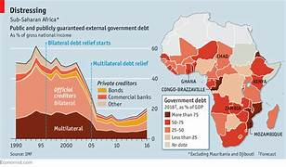
In the eighties and especially in low- and middle-income countries (LMIC), the financial aggressivity of the International Monetary Fund (IMF) cut to subsidized staple foods and implemented the recommendation to put a price on land: the effect is the privatization of large parts of the commons (for example, in Africa) rendering the already difficult self-sustenance agriculture almost impossible.
The processes of impoverishment and expropriation can be seen as caused by the green need of protecting nature or human survival, this last one also celebrated thanks to extremely expensive vaccinations. These processes are justified by “objectives” needs - that is, thought and presented as never directed or planned by human beings - and therefore not at all recognized as having violent effects (because concealed).
Another amazing consequence of what we can call “green new enclosures” is and will further be a devaluation for all properties already lacking the minimum green requirements that so candidly offered to the exciting economical aggression of the globalized rich bidders or mafious organizations, that increase their already huge capitals.

Slide 10
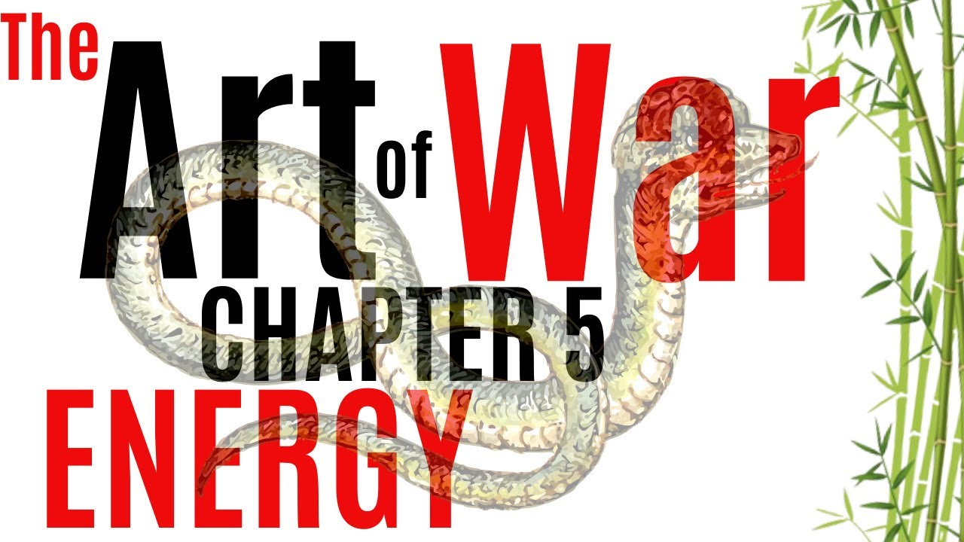
Mainstream mass media repeatedly say that Ukraine war is leading to a global food and energy crisis. In various countries, such as Germany and Italy, the effect could be terribly devastating: the virtual embargo against Russian gas already produces in these countries a slowdown in production activities (and could be extremely more violent from the economical point of view if transformed into a real embargo in the near future). Again, the general crisis generated by the war – justified in the generic terms of the defense of western democracies - is the occasion for producing new enclosures of economical activities, salaries, and small, medium size, but also big, in this case, private activities and private wealth.
Finally, we should not forget that sanctions so beloved by the EU and US (the West, so to speak), have the effect of impoverishing entire populations at the same time fostering the predatory attitude of multinational corporations and other aggressive financial agencies that can buy for cheap industries, huge land holdings, real estate markets, including residential and commercial real estate, as well as mortgage markets, that lost value.

Slide 11
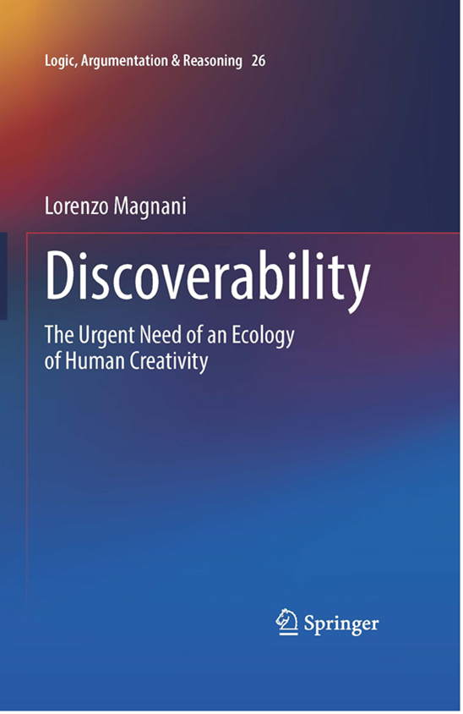
Thanks!
lorenzo.magnani@unipv.it

