Slide 1
Fallacies, Abduction, and the Logic of Eco-Cognitive Openness
Lorenzo Magnani
World Logic Day, January 15, 2024
Notes:
First slide

Slide 2


Slide 3

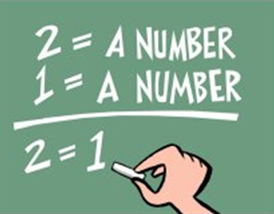
ABDUCTION AS A FALLACY: A MISTAKE OF REASONING?
FALLACIES
Traditional Fallacies, such as hasty generalization, ad hominen, and abduction are cognitive mistakes and strategical successes. It is not that it is sometimes “strategically” justified to commit fallacies (a perfectly sound principle, by the way), but rather that in the case of the Gang of Eighteen traditional fallacies they simply are not fallacies. Sometimes it is smarter to commit the error than avoid it. It is only in the perspective of an aristocratic perspective on human thinking that we can disregard their eco-cognitive character, where instead the military intelligence is at play.
Woods contends that a fallacy is by definition considered “a mistake in reasoning, a mistake which occurs with some frequency in real arguments and which is characteristically deceptive” . Hasty generalization and ad verecundiam are considered inductively” weak inferences, while affirming the consequent (abduction) is a deductively invalid inference. Nevertheless, when they are used by actual reasoners, “beings like us”, that is in an eco-logical and not merely logical – ideal and abstract – way, they are no longer necessarily fallacies. Traditionally, fallacies are considered mistakes that appear to be errors, attractive and seductive, but also universal, because humans are prone to committing them. Moreover, they are “usually” considered incorrigible, because the diagnosis of their incorrectness does not cancel their appearance of correctness.
The so-called fallacies are eco-cognitively fruitful.

Slide 4

If humans are so inclined to disregard errors it is natural to especially devote to the so-called fallacious reasoning a kind of natural, light military role, which becomes evident when more or less vital interests of various kinds are at stake. In this case arguments that embed fallacies can nevertheless aim at 1) defending and protecting ourselves and/or our group(s) – normally, human beings belong to various groups, as citizens, workers, members of the family, friends, etc. – groups which are always potential aggressive coalitions; 2) attacking, offending and harming other individuals and groups. As a way of example, it is well-known that gossip takes advantage of many fallacies, especially ad hominem, ad baculum, ad misericordian, ad verecundiam, ad populum, straw man, and begging the question.
NATURALIZATION of LOGIC approach provides a unified perspective on unfortunately separated and fragmented fields of research about alternative rationalities (Evolutionary Psychology, Moral Philosophy, Neuroscience, Cognitive Science, Cognitive Psychology, Anthropology, etc.):
The Violent Nature of Language
Scapegoating, Bullying
Semantic Attack Bullshit, Confabulation
Perversion, Depression, Psychopathic/Sociopathic Behaviors
Violence and Narcissism
Self-Deception/Bad Faith
Emotions and Rationality
Heuristics/Ecological Rationality/Creativity
Religious, Magical, Mythical Thinking
Moral Engagement and Disengagement
«MILITARY INTELLIGENCE»
There is a general “military” nature of human language I have described in (Magnani, 2011), which I will recall again below: 1) human language possesses a “pregnance-mirroring” function, 2) in this sense we can say that vocal and written language is a tool exactly like a knife; 3) the so-called fallacies, are certainly linked to that efficacious “military intelligence”, which relates to the problem of the role of language in the so-called coalition enforcement, which characterizes all the various kinds of groups and collectives of humans.
These cognitive acts in turn clearly testify that cognition can be successful and useful even in the presence of bounded information and knowledge and, moreover, in the absence of sound inferences. In this perspective, deeper knowledge and sound inferences lose the huge privileged relevance usually attributed to them by the intellectual
philosophical, epistemological, and logical tradition. “Belief” seems sufficient enough for human groups to survive and flourish, as they do, and indeed belief is more “economical” than knowledge as at the same time it simulates knowledge and conceals error.

Slide 5
LANGUAGE AS MORAL AND VIOLENT CARRIER
Thom clearly acknowledges the intrinsic “military” (and so moral, normative, argumentative, etc.) nature of language, by providing a justification in terms of the catastrophe theory- However, it is in the arguments traditionally recognized as fallacious, that we can more clearly grasp the military nature of human language and especially of some hypotheses reached through the so-called fallacies
This “military‘” nature is not evident in various aspects and uses of syntactilized human language. It is hard to directly see the coalition enforcement effect in the many epistemic functions of natural language, for example when it is simply employed to transmit scientific results in an academic laboratory situation. However, we cannot forget that even the more abstract character of the knowledge packages embedded in certain uses of language (and in hybrid languages, like in the case of mathematics, which involves considerable symbolic parts) still plays a significant role in changing the moral behavior of human collectives.
Language efficiently transmits vital pieces of information about the fundamental biological opponents (life, death -- good, bad) and so it is intrinsically involved in moral/violent activities. This conceptual framework, together with the eco-logical approach, also sheds further light on some fundamental dialectical and rhetorical roles played by the so-called fallacies, which are of great importance to stress some basic aspects of human abductive cognition.

Slide 6
Deduction as Eco-Cognitive Immunization
DEDUCTION AS ECO-COGNITIVE IMMUNIZATION
1. In syllogistic theory local/environmental cognitive factors - external to the inferential process, regarding users/reasoners, are given up. Accordingly, a logic gets consequence right if it is right for sets of sentences taken without reference to factors of speaker-use and other pragmatic considerations.
2. Syllogism is considered as a context-free sequence of (on most accounts) three categorical propositions.
3. Aristotle himself expressly contends that the necessity of this kind of reasoning is related to the circumstance that “no further term from outside is needed”, in sum syllogism is the fruit of a kind of eco-cognitive immunization.

Slide 7
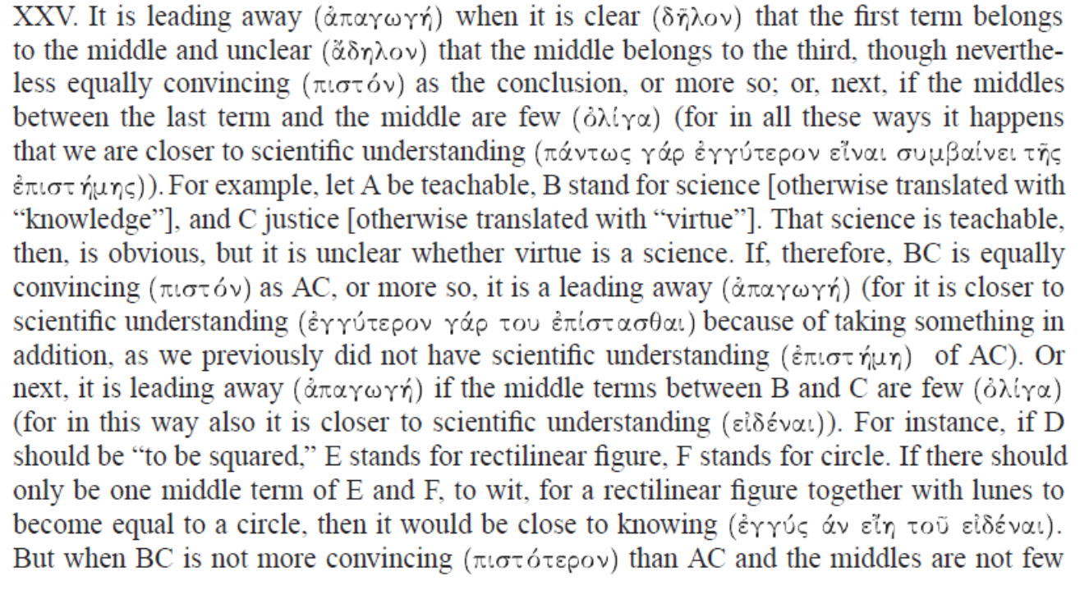
SITUATEDNESS: TRUTH CREATIVITY
Abduction is related to local, pragmatic, user-sensitive factors associated to situatedness, that is to factors that are subject to the influence of strong eco-cognitive constraints and chances. Aristotle:

Slide 8

MAXIMIZING COGNITION
ECO-COGNITIVE ENVIRONMENTAL SITUATEDNESS AND ABDUCTIVE COGNITION
In human scientific discovery it is common to recur to disparate external models to make analogies or to favor other cognitive strategies (prediction, simplification, confirmation, etc.) to support the abductive creative process, as I explained in
The Abductive Structure of Scientific Creativity (2017).
I contend that scientific discovery is characterized by a maximization of eco-cognitive openness and situatedness.
Enhancing diagnosticability and discoverability is fundamental.
.

Slide 9


LOCKED ABDUCTIVE STRATEGIES UNDERMINE THE MAXIMIZATION OF ECO-COGNITIVE OPENNESS
LOCKING STRATEGIES AFFECTS CREATIVITY
I contend that to reach rich selective or creative good abductive results efficient strategies have to be exploited, but it is also necessary to count on an environment characterized by what I have called optimization of eco-cognitive situatedness, in which eco-cognitive openness is fundamental. To favor good creative and selective abduction reasoning strategies must not be “locked” in an external restricted eco-cognitive environment, such as in a scenario characterized by fixed definitory rules and finite material aspects, which would function as cognitive mediators able to constrain agents’ reasoning. You cannot activate at your discretion a process of eco-cognitive opening in that artificial game, such as it is instead occurring, for example, in the case of scientific discovery, in which it is common to recur to disparate external models to make analogies or to favor other cognitive strategies (prediction, simplification, confirmation, etc.) to support the abductive creative process..
I contend that scientific discovery is characterized by a maximization of eco-cognitive openness.
Enhancing diagnosticability and discoverability is fundamental.

Slide 10

JEOPARDIZING HUMAN ABDUCTION THROUGH IMPOVERISHED (OR “NEGATIVE”) EPISTEMIC NICHES
After all since the famous public policy disaster generated by thalidomide in the 1960s, it has been acknowledged that in medical research and development (R&D) the conflict of interests between profit maximizing of private sphere firms and those of governments would need a severe regulatory supervision.
Commercialized scientists have less obstacles - neoliberals weakened the state institutions which now no longer can satisfactorily rule behaviors and circumstantiate distinctions between public and private interests - but are oppressed by pre-established agendas. Not only, paradoxically, and contrarily to all expectations - a new big obstacle appeared: once “commercialized” and dependent upon the private sectors, the scientists are no more able to communicate research results freely, so that negative freedom, otherwise defended, is instead violated. For example, this outcome affects both sponsored biopharmaceutical industry and agricultural biotechnology, where for-profit corporations have a tendency to only consider research that is beneficial to them financially and to avoid research that is not (Elliott 2012).

Slide 11

In sum, various aspects of decision-making in commercialized scientific research (i.e., in biomedical areas), are jeopardizing discoverability in science, so scientific creativity and human creative abduction in general. Some knowledge is rendered secret because of national security or because of business interests.

Slide 12
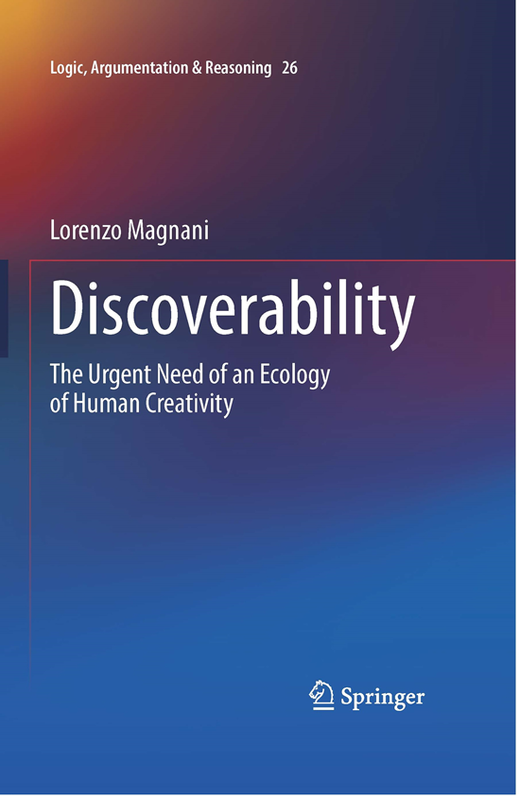
Lorenzo Magnani
Discoverability
The Urgent Need of an Ecology of Human Creativity
Springer

Slide 13

Thanks!

