Slide 1
“AI Generating New Habits. Critical Reflections”
The place and role of humans
in the age of Generative AI
Yurii Mielkov
(Kyiv, Ukraine)

Slide 2
The Challenges of Generative A.I.
Possible human extinction?
Inability to control A.I.
The threat of unemployment
Notes:
OpenAI: 80% робітників можуть вважати, що AI впливає на їх роботу.

Slide 3
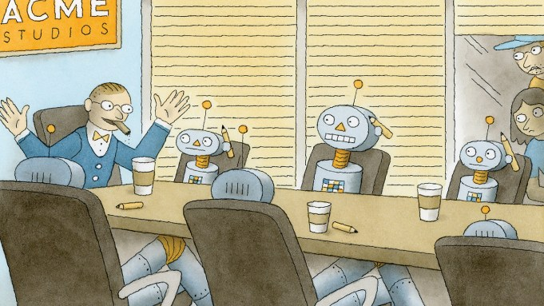
Jobs A.I. can replace in 20 / 50 years
60% / 90% of truck drivers
20% / 50% of surgeons
50% / 80% of retail salespersons
Notes:
Угроза есть, но она в другом.
Прежде всего, математики, бухгалтеры, финансовые аналитики, веб-дизайнеры, писатели... Но это говорит скорее о качестве их писаний! Ну а остальных это как раз и избавит от машинной работы.
Mitchell says the actual strengths of AIs like ChatGPT—assisting with creativity, ideation, and menial tasks—are being sidelined in favor of shoehorning the technology into moneymaking machines for tech giants

Slide 4
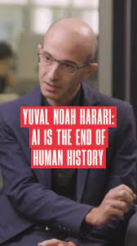
Dataism and The End of Humanity
AI is learning to do everything, humans are becoming obsolete for the future
“Dataism”: data is everything; who controls data, controls the future
“Transhumanism” and cyborgs
Notes:
“Influential people anticipate the end of humanity as we know it”
Harari, Elon Musk, Zukerberg

Slide 5
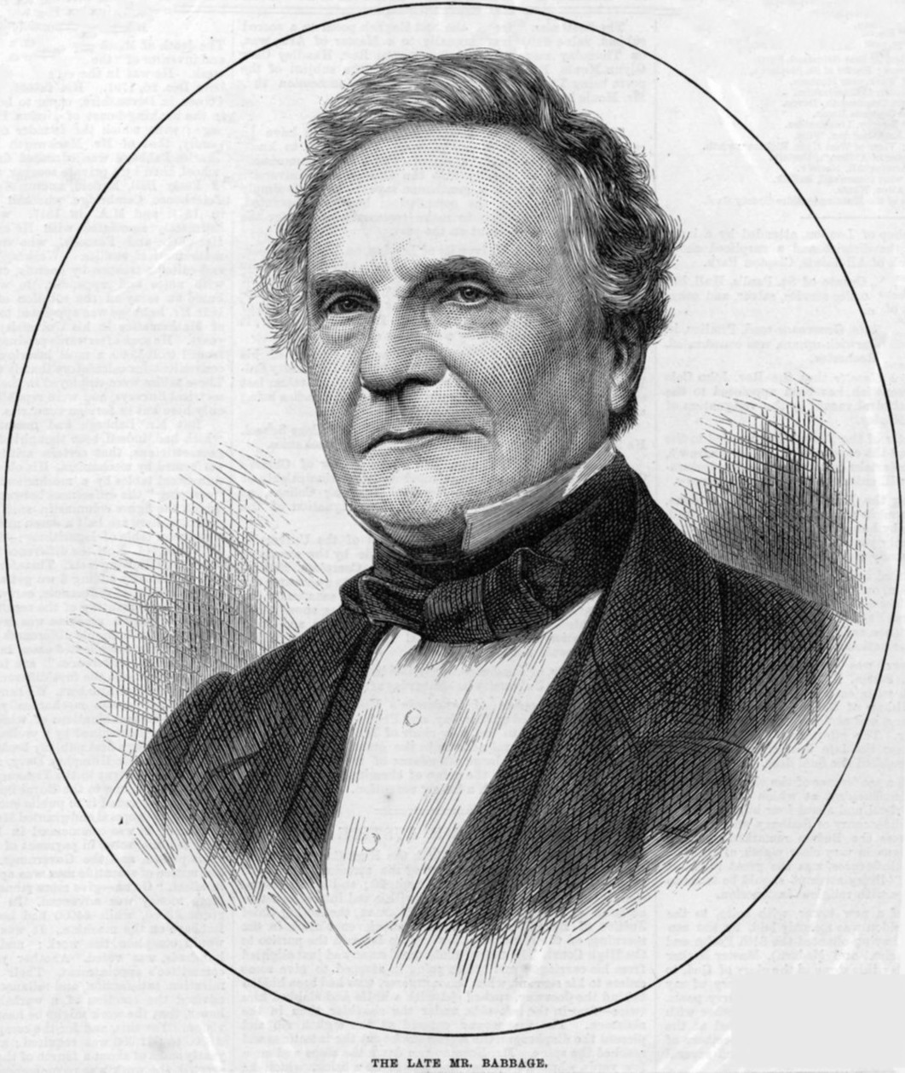
Charles Babbage (1791 - 1871)
One great advantage which we may derive from machinery is from the check which it affords against the inattention, the idleness, or the dishonesty of human agents. Few occupations are more wearisome than counting a series of repetitions of the same fact…
On the Economy of Machinery and Manufactures (1832), p. 54
Notes:
Та не дарма й два століття тому Чарльз Беббідж, один із творців самої ідеї програмованого комп’ютера, обґрунтовував приблизно ту ж саме позицію, підкреслюючи, що перевага машин полягає в наданні ними засобу «проти неуважності, неробства або нечесності людського фактору».
Для сравнения: Карл Маркс, один из немногих учёных XIX в., ценивших вклад Бэббиджа в экономические исследования машин и фабричного производства, приходил к прямо противоположным выводам относительно такого принципа разделения труда, видя в нём источник сегрегации и социальной несправедливости. И даже дальнейшее развитие и внедрение машин представало в этом свете не более чем новым способом подавления человека: «В мануфактуре и ремесле рабочий заставляет орудие служить себе, на фабрике он служит машине. Там движение орудия труда исходит от него, здесь он должен следовать за движением орудия труда. В мануфактуре рабочие являются членами одного живого механизма. На фабрике мёртвый механизм существует независимо от них, и они присоединены к нему как живые придатки… Машинный труд, до крайности захватывая нервную систему, подавляет многостороннюю игру мускулов и отнимает у человека всякую возможность свободной физической и духовной деятельности. Даже облегчение труда становится средством пытки, потому что машина освобождает не рабочего от труда, а его труд от всякого содержания» («Капитал», т. 1, гл. 13).
Конечно, вряд ли можно обвинять выдающегося изобретателя «Аналитической машины» в попытке обосновать некую теорию контроля и господства компьютера над человеком! Но, наверное, в эпоху, когда вычислительная машина стала неотъемлемой частью повседневной жизни, и поручают ей уже далеко не только «элементарные арифметические операции», всё-таки стоит немного задуматься и о том, что привело к переходу звания «компьютер» от человека к машине – и что может или должно из этого следовать?

Slide 6
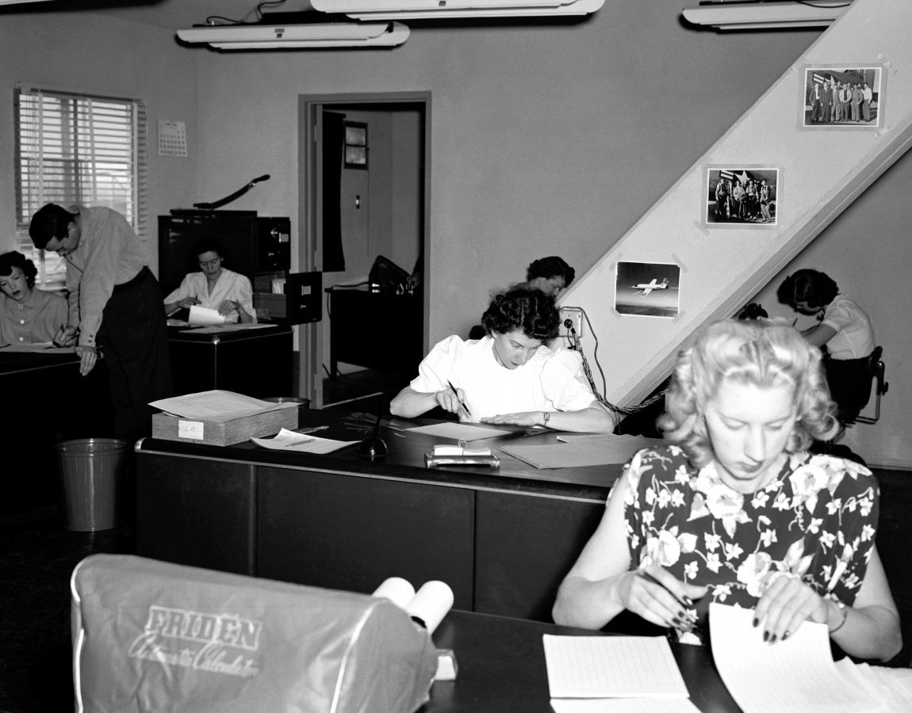
When Computers were Human
Notes:
It would be interesting to remind ourselves that computers actually “were human” – to use the apt title of David Grier’s book [3] – up until the late 1940s: human computers – mostly women, as low-paid workers, but usually more accurate workers than men – performed the simplest calculations, particularly those associated with both military aviation and the development of the atomic bomb in the USA. Moreover, with the emergence of electronic computers, their “operators” have often been recruited from yesterday’s human computers, which thus became first programmers. Still, such computing is indeed a monotonous routine labor that machines are definitely better at than human persons. In fact, the trends in today’s society, particularly in higher education and knowledge transfer, provide good examples on how the ICT can truly augment human persons by empowering them with new possibilities, while still requiring more creativity and more responsibility as well.
Grier, D. A.: When Computers Were Human. Princeton University Press, Princeton (2005).

Slide 7
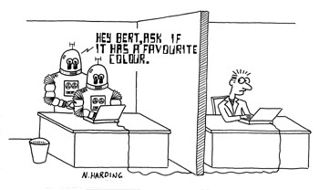
Can a machine think?
Notes:
There is no doubt that an advanced machine can process information, including reasoning and learning, and it definitely can do it faster and maybe more efficiently than humans. But can artificial intelligence, well, think? When Alan Turing tried to consider that question in the 1940s and 1950s, he famously turned it from philosophical or psychological perspective into more practical one—by proposing the idea of what later got the name of the Turing test. The computer was declared to be considered as an intelligent and thinking entity if it could actually pass as a human—if an unknowing interrogator will not be able to distinguish between a human answering questions and a machine answering the same questions. Still, even by the end of 2022, no A.I. program has ever come close to passing such a test: even ChatGPT-4 is not believed to have passed it by all of the experts [7].
«...despite the usefulness of artificial intelligence… no computer can ever duplicate the intelligence of a human being because of the many dimensions of human intelligence that involve characteristics that we believe cannot be duplicated by silicon-based forms of intelligence because machines lack a number of essential properties that only a flesh and blood living organism, especially a human, can possess… There is a subjective, non-rational (or perhaps extra-rational) aspect of human intelligence, which a computer can never duplicate»
Braga A., Logan R.K. (2021) The Singularity Hoax: Why Computers Will Never Be More Intelligent than Humans. In: Hofkirchner W., Kreowski HJ. (eds) Transhumanism: The Proper Guide to a Posthuman Condition or a Dangerous Idea? P.133-134

Slide 8
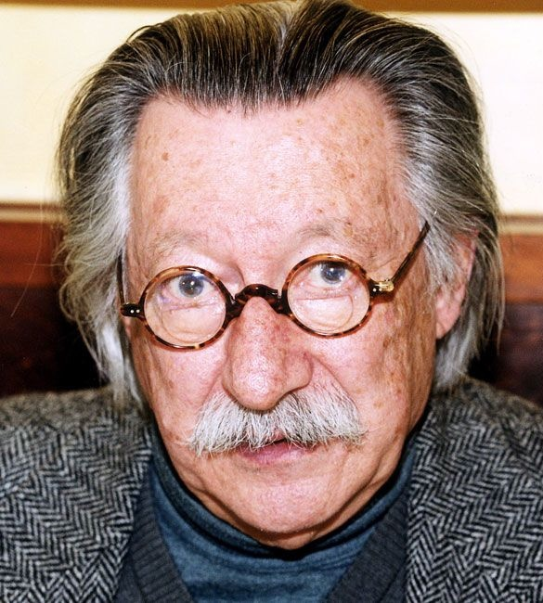
Joseph Weizenbaum (1923-2008)
«I shall argue that an entirely too simplistic notion of intelligence has dominated both popular and scientific thought, and that this notion is, in part, responsible for permitting artificial intelligence's perverse grand fantasy to grow. I shall argue that an organism is defined, in large part, by the problems it faces. Man faces problems no machine could possibly be made to face. Man is not a machine. I shall argue that, although man most certainly processes information, he does not necessarily process it in the way computers do. Computers and men are not species of the same genus.»
Computer Power and Human Reason: From Judgment to Calculation (1976), p.203
Notes:
I would also argue that the illusion of mathesis universalis acts as an illusion of the possibility of standardizing scientific activity, although strict and legally unambiguous formulations, in particular, of the same academic integrity, cannot fully correspond to scientific culture – as based largely on implicit knowledge, on the transfer of unarticulated skills and worldviews from a teacher to a student within informal scientific schooling and collaboration.
Of course, the skepticism towards machines and the doubt of the ready-made usefulness of information does not mean questioning or abandoning technological development and computers and the Internet – it is just a matter of properly understanding these phenomena and recognizing their limitations and inadequacies for science and culture in general. The limitation in question was clearly pointed out in particular by one of the ‘fathers’ of modern artificial intelligence (AI) technologies, Joseph Weizenbaum, who always emphasized that the operation of an electronic machine is an abstract game that is separated from the real world. Already in the 1960s and 1970s, the researcher has observed with great astonishment the formation of a subculture of computer scientists and hackers – he used to call them ‘machine addicts’ – who are immersed in their artificial world, created by themselves: they possess skills, but they lack knowledge, and could be compared to some illiterate book copyists in a medieval monastery. The traditional engineer, Weizenbaum argues, can come to terms with the fact that there are things he does not know – while a contemporary programmer lives and acts in his own world, blindly believing that this world is completely subject to him.

Slide 9
Some AI Terminology
Intelligence ≠ Intellect
Information ≠ knowledge
Generative ≠ creative
AI ≠ subject of activity
Notes:
According to the current version of the corresponding article in Encyclopedia Britannica, artificial intelligence is defined as the ability of a computer to perform tasks commonly associated with intelligent beings, particularly the ability to reason, discover meaning, generalize, or learn from past experience [7]. Still, all those tasks are done by computers who are programmed to carry them out—they can’t do anything otherwise. Learning could be done by trial and error, and the ability to reason or to generalize could be achieved by following the strict and clear rules of formal logic, but arguably there is nothing besides that.

Slide 10
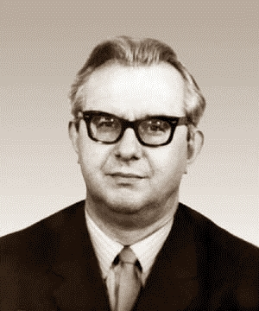
Pavel Kopnin (1922 - 1971)
“Machine thinking” has unlimited possibilities for its development, but not as some kind of independent thinking, taken away from human thinking, but as its subordinate moment, its side... A human will transfer an increasing number of functions performed by him or her in the process of thinking to the machine, leaving only the major one - thinking itself as spiritual production, the creation of scientific concepts, theories, ideas...
The concept of thinking and cybernetics (1961)
Notes:
Копнин: машина не может мыслить, мыслит человек, как он же роет землю и наблюдает небо, not excavator not a telescope!
Рассудочное действие по шаблону в пределах формальной логики. Мышление есть продукт общественной истории. Оно всегда принадлежит человеку как субъекту. «Машинное мышление» имеет неограниченные возможности для своего развития, но не как какое-то самостоятельное мышление, оторванное от человеческого, а как его подчинённый момент, сторона. «Думающие машины» будут вторгаться в самые различные сферы нашей духовной деятельности, их дальнейшее развитие является одной из характерных особенностей современного научного мышления. Но какими бы «умными» они ни были, они останутся только материальным средством теоретической деятельности человека. Человек всё большее число функций, выполняемых им в процессе мышления, будет передавать машине, оставив за собою главную, – само мышление как духовное производство, создание научных понятий, теорий, идей, в которых отражаются закономерности объективного мира» (112).

Slide 11
HI vs. AI
Openness: AI can only perform “closed” tasks
Polyparadigmality: AI cannot think “out of the box”
Morality: AI deals only with the purely rational side of “thinking”
Notes:
That opinion is shared and expressed not only by humanitarians who can envy the A.I.; for instance, Jaron Lanier, a prominent computer scientist and philosopher, who is considered to be the founder of the whole field of “virtual reality” research, even argues that the very term “A.I.” is misleading and even dangerous because it implies something it is not and could never actually be:
“A program like OpenAI’s GPT-4, which can write sentences to order, is something like a version of Wikipedia that includes much more data, mashed together using statistics. Programs that create images to order are something like a version of online image search, but with a system for combining the pictures. In both cases, it’s people who have written the text and furnished the images. The new programs mash up work done by human minds. What’s innovative is that the mashup process has become guided and constrained, so that the results are usable and often striking. This is a significant achievement and worth celebrating—but it can be thought of as illuminating previously hidden concordances between human creations, rather than as the invention of a new mind” [12].

Slide 12
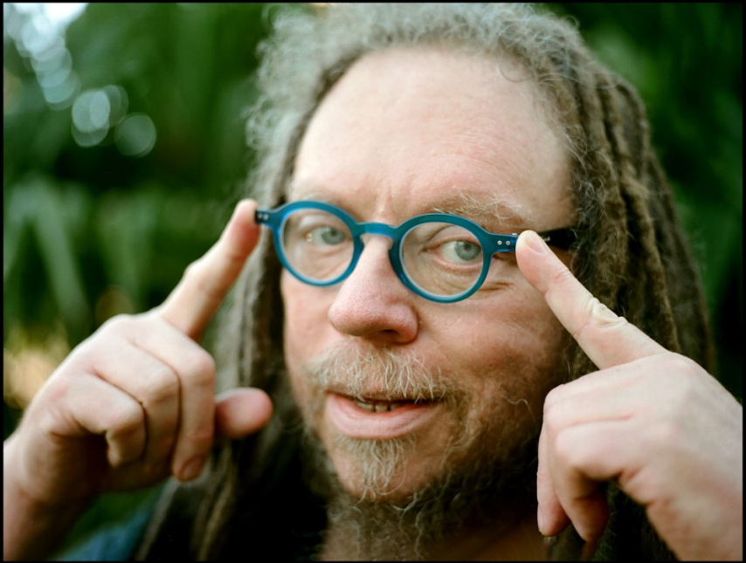
Jaron Lanier (b. 1960)
The new programs mash up work done by human minds. What’s innovative is that the mashup process has become guided and constrained, so that the results are usable and often striking. This is a significant achievement and worth celebrating – but it can be thought of as illuminating previously hidden concordances between human creations, rather than as the invention of a new mind.
There is no A.I. (2023)
Notes:
Jaron Lanier, an American scientist and philosopher, who has coined one such popular term himself (that one is “virtual reality”), finds such a situation not only misleading, but even dangerous. In his essay with the eye-catching title “There is no A.I.” [6], Lanier argues that it is much more appropriate to think of A.I. as a tool, not a creature capable (or not capable) of possessing a kind of intelligence – the latter would be just mythologizing the technology.
And the technology in question is not some self-sufficient entity, but an innovative form of social collaboration between humans. In other words, the technology we call artificial intelligence can’t create anything in principle – it is not the subject of any activity at all, to say nothing of it being an intelligent or a cognizing subject. That technology can but combine something already created by humans basing on its programming coded again by humans themselves – as Lanier puts it, such programs “mash up work done by human minds”, and the one innovation here that enables us talking about a significant improvement is that the mashup process in question becomes even more guided and constrained now, providing more elaborate and sound results. “A program like OpenAI’s GPT-4, which can write sentences to order, is something like a version of Wikipedia that includes much more data, mashed together using statistics. Programs that create images to order are something like a version of online image search, but with a system for combining the pictures. In both cases, it’s people who have written the text and furnished the images. The new programs mash up work done by human minds. What’s innovative is that the mashup process has become guided and constrained, so that the results are usable and often striking. This is a significant achievement and worth celebrating – but it can be thought of as illuminating previously hidden concordances between human creations, rather than as the invention of a new mind”.

Slide 13
Openness and Closeness of Thinking
Notes:
As an example, we can refer to the experiments by Alexander Luria, one of the founders of Ukrainian psychology (particularly, of the Kharkiv Psychological School), conducted in 1931–1932 in rural areas of Uzbekistan. Luria proposed local residents a question representing a simple syllogism. It is known that there are no camels in Germany, and Berlin is the capital of Germany—so the question is: are there any camels in Berlin?
It was found that elder people who did not receive any kind of formal education usually said ‘yes’ in response to the question. When asked to explain their answer, they replied that Berlin is a big city, which means that there should be a bazaar there—so it is quite probable then that an Uzbek with a camel could come to that bazaar. At the same time, younger people who have studied in at least elementary modern school solved that syllogism problem just immediately and without any hesitation—the correct answer is “no”: there are no camels in Germany [13].

Slide 14
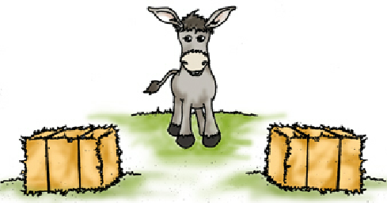
Linear and Non-linear thinking
Notes:
Not programmed! RND is not desirability / evaluation.

Slide 15
Linear and Non-linear thinking
Notes:
Values! Информация – знание – мудрость

Slide 16
AI and the perspectives of humanism
AI does not create knowledge, it processes information
AI does not “think”, it performs programmed operations, imitating or following a human person
Openness is a specific feature of human existence and thinking, inaccessible to AI
The value-moral aspect of knowledge is becoming more relevant: the threat does not come from AI, but from the peculiarities of its use as a means to achieve certain human goals
Humanist values gain more importance, as the threat lies in our inability to be human and to control AI
Notes:
Гуманизм как право и обязанность осмысления.
So there is no need to fear AI as it would never "replace" humans, as it can't actually do anything by itself. And dataism is self-denying as any data is useless unless being processed into knowledge, and only humans are capable of doing that! And – well, it is hard to expect from politicians or businessmen to be philosophers and to understand those things anyway.

Slide 17
The place and role of humans in the age of Generative AI
Thanks for your attention!
Notes:
A.I. does not create new data or knowledge, it either processes the available information or follows some patterns, like imitating an artist or a writer. Thus, intelligence here is quite different from human intelligence, so the very usage of the term, albeit already established, is dubious. Artificial intelligence is a closed intelligence: even its learning is based on certain programs and sets of instructions. It cannot think openly, “out of the box”, going beyond the boundaries of purely rational reasoning and formal logic peculiar to classical type of rationality.

